Slide 1

Profesor: M. Sc. Lorna Castro Aponte
HISTORY OF THE CULTURE OF ENGLISH SPEAKING COUNTRIES
Unit # 1: Genesis of the United States of America
Theme: Introduction to the Discipline
Origins of the United States of America. Introductory lecture on American geography, national symbols, history and culture. The Landscape: The Native Americans

Slide 2
Plan temático
Temática#1: Génesis de los Estados Unidos de América
Temática# 2: Desarrollo y expansión de la nueva nación 1787-1860
Temática# 3: Esclavitud y Guerra Civil
Temática# 4: Reconstrucción, expansión y desarrollo monopolista: 1865-1898
Temática# 5: Del new Deal a la Guerra Fría .
Temática# 6: De los tormentosos 60 hasta América Primero.
Temática# 7: Las relaciones de EUA con Cuba a partir de 1959.
Temática# 8: De los años 90 a la actualidad

Slide 3
Contents of the unit # 1
1. Origins of the United States of America. Introductory lecture on American geography, national symbols, history and culture. The Landscape: The Native Americans.
2. Pre-Colonial America; conquest and colonization.
3. American colonial society. The Thirteen Colonies
4. The sources of the American Revolution
5. Political Documents of the Revolutionary War: The Declaration of Independence.
6. The revolutionary war. The results of the Revolution
7. The Constitution of 1787

Slide 4
OBJECTIVES:
1) To make a sketch of the main geographical features of the United States of America.
2) To trace the general characteristics of Native American cultures, the process of colonization and the main characteristics of the colonies up to before the Revolution

Slide 5
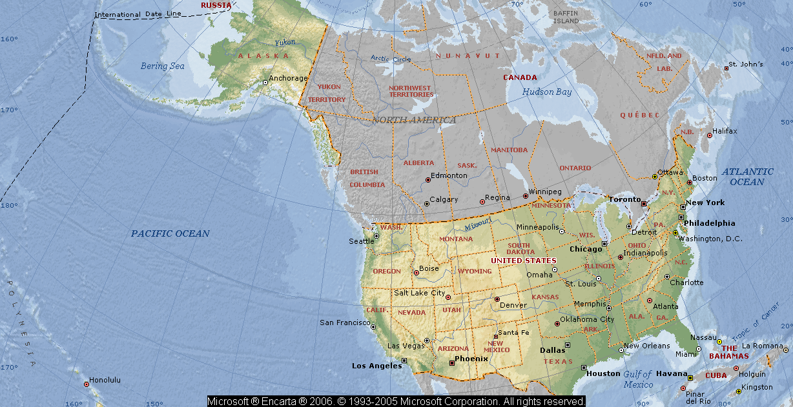
Country of North America, a federal republic of 50 states. Besides the 48 contiguous states that occupy the middle latitudes of the continent, the United States includes the state of Alaska, at the northwestern extreme of North America, and the island state of Hawaii, in the mid-Pacific Ocean. The coterminous states are bounded on the north by Canada, on the east by the Atlantic Ocean, on the south by the Gulf of Mexico and Mexico, and on the west by the Pacific Ocean. The United States is the fourth largest country in the world in area (after Russia, Canada, and China). The national capital is Washington, which is coextensive with the District of Columbia, the federal capital region created in 1790.

Slide 6
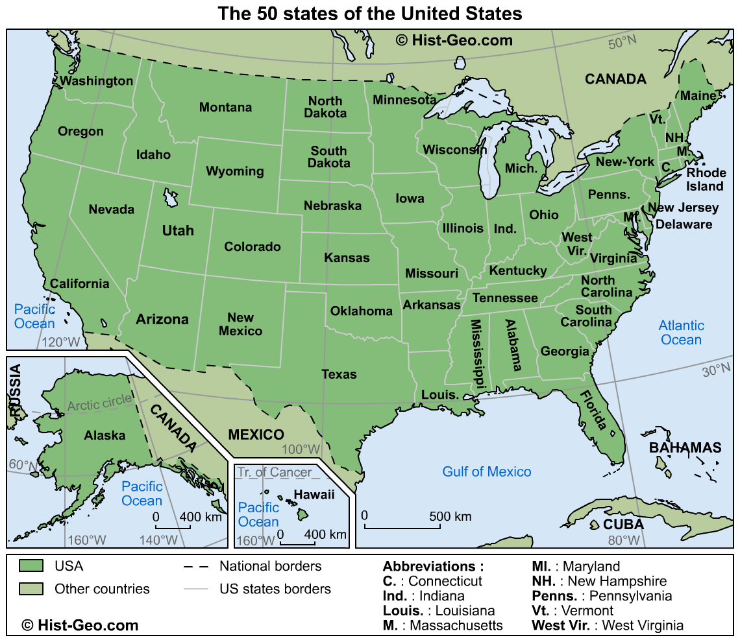

Slide 7
The United States contains a highly diverse population. Probably no other country has a wider range of racial, ethnic, and cultural types than does the United States. In addition to the presence of surviving native Americans (including American Indians, Aleuts, and Eskimo) and the descendants of Africans taken as slaves to America, the national character has been enriched, tested, and constantly redefined by the tens of millions of immigrants who by and large have gone to America hoping for greater social, political, and economic opportunities than they had in the places they left.

Slide 8
The United States is the world's greatest economic power, measured in terms of gross national product (GNP). America was the first of the European colonies to separate successfully from its motherland, and it was the first nation to be established on the premise that sovereignty rests with its citizens and not with the government.
In its first century and a half, the country was mainly preoccupied with its own territorial expansion and economic growth and with social debates that ultimately led to civil war and a healing period that is still not complete. In the 20th century, the United States emerged as a world power, and since World War II, it has been one of the preeminent powers. It has not accepted this mantle easily nor always carried it willingly; the principles and ideals of its founders have been tested by the pressures and exigencies of its dominant status. Although the United States still offers its residents opportunities for unparalleled personal advancement and wealth, the depletion of its resources, contamination of its environment, and continuing social and economic inequality that perpetuates areas of poverty and blight all threaten the fabric of the country.

Slide 9
The Landscape
North America is a huge continental mass with the shape of a rough triangle. About 3000 miles across at the north, it narrows to a few miles at the Isthmus of Panama. Three oceans bathe its shores: the Pacific, the Atlantic, and the Arctic. Two mountain ranges traverse the continent from north to south—the Appalachians in the east and the Rocky Mountains in the west.

Slide 10
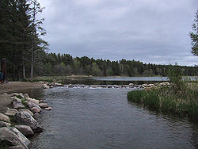
The vast area that stretches between these mountainous regions is drained by the vast Mississippi River. The region west to the Rocky Mountains is a fertile region of tempered climate. The North American Continent is very rich in natural resources. Most of the United States of America lies here, between the twenty-fifth and the forty-ninth parallels. Hawaii, the fiftieth, state is far away in the Pacific Ocean.

Slide 11


National symbols
United States’s flag Great seal of the United States

Slide 12
American flag
the flag consists of thirteen horizontal stripes, seven red alternating with 6 white. The stripes represent the original 13 colonies, the stars represent the 50 states of the Union. The colors of the flag are symbolic as well: Red symbolizes Hardiness and Valor, White symbolizes Purity and Innocence and Blue represents Vigilance, Perseverance and Justice.
For more than 200 years, the American flag has been the symbol of their nation's strength and unity. It's been a source of pride and inspiration for millions of citizens.

Slide 13
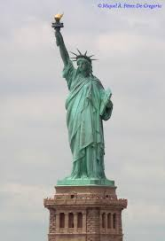

National symbols
Statue of Liberty
Uncle Sam

Slide 14
Uncle Sam: iHis real name was Samuel Wilson , he was a merchant who fought in the war of Idependence.
Statue of Liberty: it was not created in the United States , it was created by a french sculptor named Frederic Knowzmt. The sculpure has a splint on the left that says: July 4 ,1776, when it proclaimed the Declaration of Independence. The full name of the statue is Liberty enlightening the world, and it was a gift from France to the United States that symbolizes love of both countries to democracy.

Slide 15
"The Star-Spangled Banner" is the national anthem of the United States of America. The lyrics come from "Defence of Fort M'Henry", a poem written on September 14, 1814 by the 35-year-old lawyer and amateur poet Francis Scott Key after witnessing the bombardment of Fort McHenry by British ships of the Royal Navy in Baltimore Harbor during the Battle of Baltimore in the War of 1812. Key was inspired by the large American flag, theStar-Spangled Banner, flying triumphantly above the fort during the American victory. "The Star-Spangled Banner" was recognized for official use by the United States Navy in 1889, and by U.S. President Woodrow Wilson in 1916, and was made the national anthem by a congressional resolution on March 3, 1931

Slide 16
The Native Americans. Characteristics
In the United States, Native Americans (also known as American Indians, Amerindians or simply Indians; are people descended from the Pre-Columbian indigenous population of the land within the country's modern boundaries. These peoples were composed of numerous distinct tribes, bands, and ethnic groups, and many of these groups survive intact today as partially sovereign nations.
The first Europeans reached North America in the Fifteenth Century, there were in this continent about twenty-five million Native Americans—misnamed “Indians” by Christopher Columbus and other explorers, who thought they had reached India—belonging to about 600 tribes. They spoke hundreds of languages that fell into many families. They lived in communities at different levels of organization, some in small migrant bands, others in well-established towns. They shared varied religious beliefs and made their living by hunting, fishing or raising crops

Slide 17
Amerindians men and women, naked, tawny, and full of wonder, emerged from their villages onto the island’s beaches and swam out to get a closer look at the strange big boat. When Columbus and his sailors came ashore, carrying swords, speaking oddly, the Indians ran to greet them, brought them food, water, gifts. He later wrote of this in his log:
They...brought us parrots and balls of cotton and spears and many other things, which they exchanged for the glass beads and hawks’ bells. They willingly traded everything they owned. They were well-built, with good bodies and handsome features. They do not bear arms, and do not know them, for I showed them a sword, they took it by the edge and cut themselves out of ignorance. They have no iron. Their spears are made of cane— they would make fine servants. With fifty men we could subjugate them all and make them do whatever we want.
Columbus wrote:
As soon as I arrived in the Indies, on the first Indies, on the first Island which I found, I took some of the natives by force in order that they might learn and might give me information of whatever there is in these parts.
The information that Columbus wanted most was: Where is the gold?

Slide 18
Así sean llamadas tribus, nativos indígenas o pueblos aborígenes, primeras naciones, adivasis, o indígenas estadounidenses los pueblos indígenas son grupos étnicos que desde tiempos antiguos habitan regiones particulares. Otro término común para designar a esos grupos es “habitantes originarios”, porque su asentamiento en un lugar precede a la historia moderna. Una galería fotográfica permite darle un vistazo general al arte y la sociedad de los pueblos indígenas

Slide 19
Danza de los Espíritus (Ghost Dance)

Slide 20
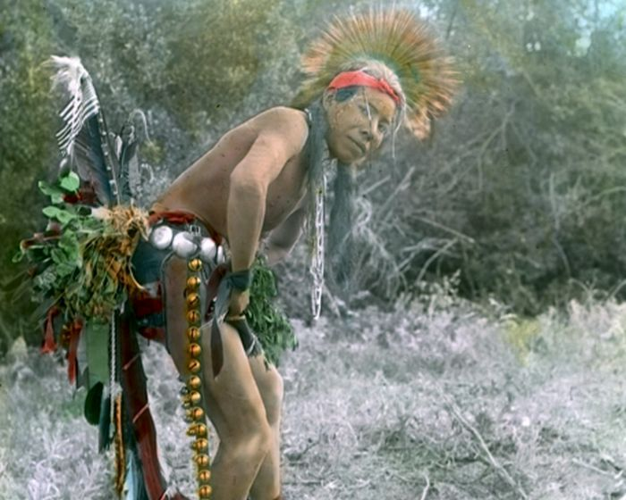
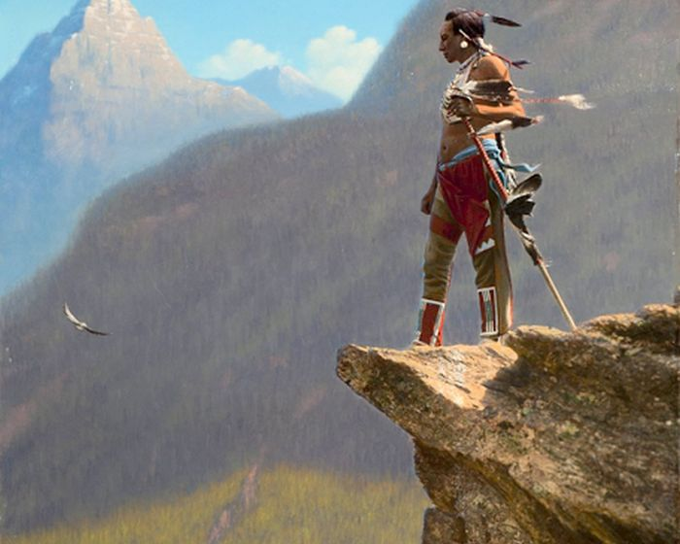
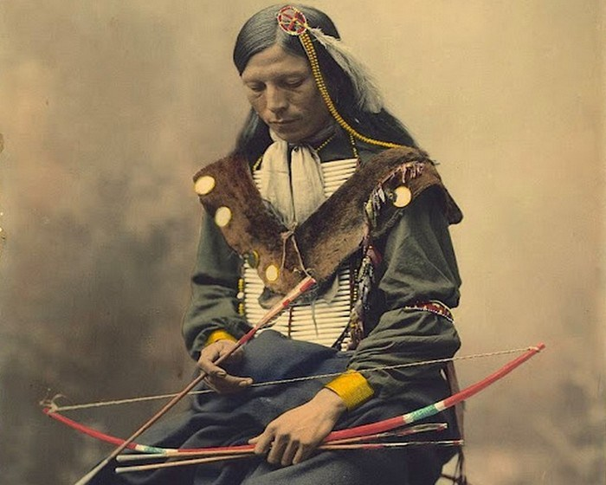
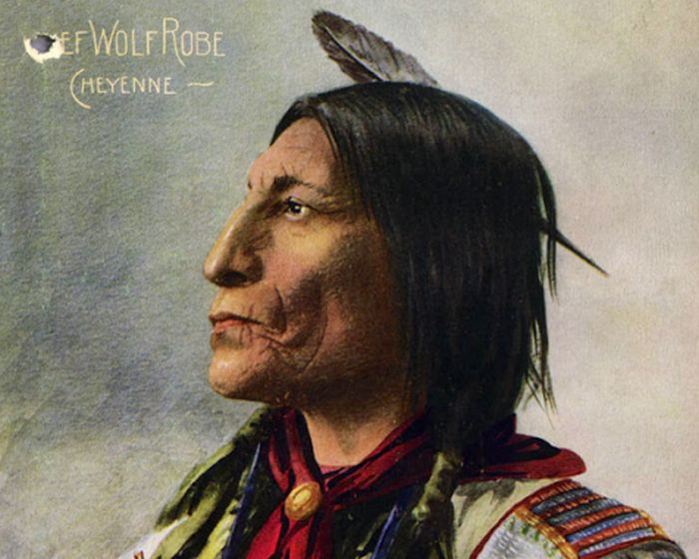

Slide 21
Most Native American societies, at the time of the conquest, lived in some form of tribal communalism based on the common ownership, control and usage of the land on a tribal basis whether the tribe made its living by hunting, fishing, farming, or by a combination of all these occupations. Tribes were relatively small in number of members. They were scattered all over a vast territory, separated one from the other by vast forests, deserts or mountains.

Slide 22
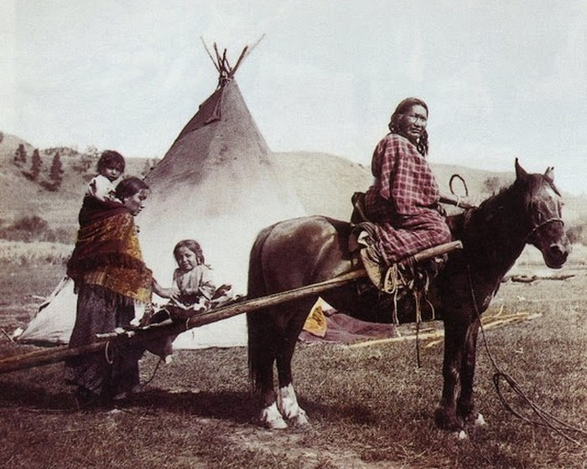
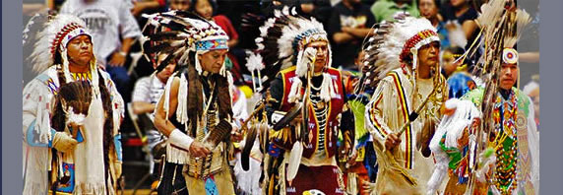
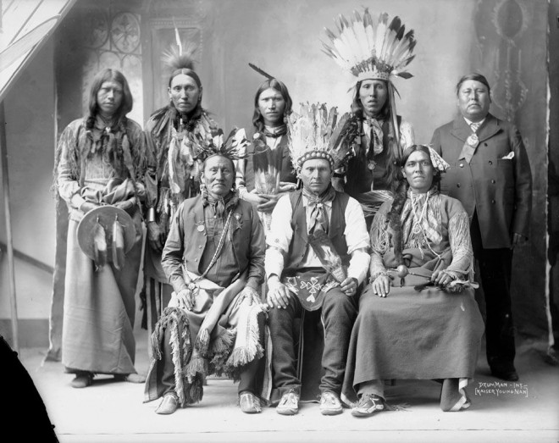
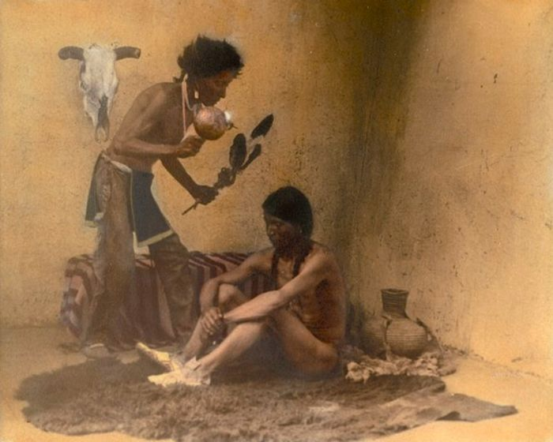

Slide 23
For the sake of study, scholars have divided the tribes into eight general geographic areas in which they lived:
The Eastern Woodland.
The Southeast.
The Plains.
The Plateau.
The Northwest Coast.
California.
The Great Basin
The Southwest.

Slide 24
The Native Americans had developed technical innovations that allowed them to survive in different geographical and climatic conditions, sometimes rigorously wild, as those prevailing in the permafrost area of the far north. Many tribes were skilled in making bows and arrows, stone hatchets, traps, birch-bark canoes in which they were able to travel easily and quickly over the lakes and rivers for miles

Slide 25
For clothing, they used deerskin, furs of various animals such as the beaver, rabbit, and squirrel, and buffalo hides sewed with thread made from tendons of animals. Their utensils, cloth and housing were artistically decorated.
Some tribes in order to cook meat turned it slowly on a pole over the fire. Other tribes the so-called “stone boilers”— boiled the meat by dropping hot stones into a dish filled with water

Slide 26
Agriculture was well developed in many regions by the Native Americans, the first farmers of the continent. They knew about the bringing of wild plants under control and the breeding of plants by seed selection. Many tribes had learned to fertilize and cultivate the soil as well as the importance of multiple cropping. They knew how to preserve foods— berries and fruits with syrup or honey, and fruits, vegetables and meat by artificial or sun drying. Their agricultural tools may seem crude by modern standards: the shoulder blade of a deer, a flat stone chipped and tied to a stick, and sometimes a mere stick.

Slide 27
Indios americanos cosechan maíz. Grabado en madera pintado a mano con acuarelas..

Slide 28
In general terms, the Europeans arrived at a continent that was inhabited by peoples who had different degrees of civilization, in some places more sophisticated that the people of Europe.
They were a people without a written language, but with their own laws, their poetry, their history kept in memory and passed on, in an oral vocabulary more complex than Europe’s, accompanied by song, dance, and ceremonial drama. They paid careful attention to the development of personality, intensity of will, independence and flexibility, passion and potency, to their partnership with one another and with nature.

Slide 29
Nevertheless, the conquerors proceeded on the assumption that the natives had no right to the land they lived in and that it was proper and ethically correct to destroy their “savage” cultures for the sake of “civilization”. This is a history of conquest, slavery, and death.
What Columbus did to the Indians, was a frenzy in the early capitalist states of Europe. For gold, for slaves, for products of the soil, to pay the bondholders and stockholders of the expeditions, to finance the monarchical bureaucracies rising in Western Europe, to spur the growth of the new money economy rising out of feudalism, to participate in what Karl Marx would later call “the primitive accumulation of capital.” These were the violent beginnings of an intricate system of technology, business, politics, and culture that would dominate the world for the next five centuries.

Slide 30
STUDY GUIDE FOR CLASS 2
Title: The American Revolution: nature; The Declaration of Independence; Whitman’s Miracles
Objective: to explain the most important features of the American Revolution and reflect on its leading ideas as expressed in the Declaration of Independence

Slide 31
Bibliografía
Colectivo de autores (1989). A Textbook on the History of the USA up to World War I Ministerio de Educación, Editorial Pueblo y Educación.
Gaceta Oficial de la República de Cuba (2018). Reglamento del trabajo docente Metodológico. Resolución No. 2/2018 (GOC-2018-460-O25). Ministerio de Educación Superior
Ministerio de Educación Superior (MES) (AÑO). Modelo del profesional de
Ministerio de Educación Superior (MES) (AÑO). Programa de la Disciplina Práctica Integral de la Lengua Inglesa.
Ministerio de Educación Superior (MES) (2020). Programa de la Asignatura Historia de la Cultura de los pueblos de habla inglesa III
Manuel de Jesús Velázquez León y Yunier Pérez Sarduy (2014). The American Saga. History of the English Speaking Cultures II

