Slide 1

Artemisa University
Humanistic and Social Sciences Faculty
Languages Department
THEORETICAL METHODOLOGICAL DESIGN
Author: Liana Arias Trovado

Slide 2
TITLE
SET OF ACTIVITIES FOR THE DEVELOPMENT OF THE VOCABULARY RELATED WITH TOURISM IN THE ENGLISH SUBJECT IN 9th GRADE AT ´´COMBATE DE SOROA´´ SECONDARY SCHOOL IN CANDELARIA.
TÍTULO
CONJUNTO DE ACTIVIDADES PARA EL DESARROLLO DEL VOCABULARIO RELACIONADO CON EL TURISMO EN LA ASIGNATURA DE INGLES EN 9° GRADO EN LA ESCUELA SECUNDARIA ´´COMBATE DE SOROA´´ DE CANDELARIA.

Slide 3
INTRODUCTION
Aquí exponen una breve reseña del Tema ( hacen un resumen de la media cuartilla)….

Slide 4
A continuación van sustituyendo cada elemento del diseño teórico- metodológico por el que ustedes tienen en su informe escrito....

Slide 5
PROBLEMATICAL SITUATION
At “Combate de Soroa” secondary school of Candelaria municipality, an important group of limitations in the development of the English language vocabulary related with tourism in 9th grade students.

Slide 6
IDEAL STATE
Students should demonstrate comprehension and identification with aspect related to the Cuban culture.
Students should understand and interchange information related to activities, experiences, people and places.
To describe in an oral and written form Cuban and local monuments, culture and gems.
Ask for help and detailed information, including directions.

Slide 7
REAL STATE
Students do not always recognize words associated to tourism activities.
Poor vocabulary in describing experiences, people, places and to talk about personalities and history of the universal, Cuban and local culture.
Students show limitations when combining words into basic sentences associated to tourism
Limited vocabulary to give directions.

Slide 8
C
O
N
T
R
A
D
I
C
T
I
O
N
Aquí explican la contradicción que tienen puesta en el informe escrito
IDEAL STATE
REAL STATE

Slide 9
SCIENTIFIC PROBLEM
How to contribute to the development of the vocabulary related with tourism in 9th grade students at ´´Combate de Soroa´´ secondary school in Candelaria municipality?

Slide 10
OBJECT OF INVESTIGATION
The teaching-learning process of English subject
FIELD OF ACTION
The development of the vocabulary related with tourism in English in 9th grade.

Slide 11
OBJECTIVE
To propose a set of activities for the development of the vocabulary related with tourism in 9th grade at ´´Combate de Soroa´´ secondary school in Candelaria.

Slide 12
Las diapos con las Scientific questions and Scientific Tasks no se leen se explican de la siguiente manera a medida que van saliendo y para quien tenga 4ta SQ and ST en este proceso investigativo no se dice:
The first scientific question and the first scientific task are related to Bibliographical References…
The second scientific question and the second scientific task are related to Characterization of the initial stage…
The third scientific question and the third scientific task are related to the set of activities….

Slide 13
SCIENTIFIC QUESTIONS
SCIENTIFIC TASKS:
Determination the theoretical and methodological referents that support the development of the vocabulary related with tourism.
What are the theoretical and methodological referents that support the development of the vocabulary related with tourism?
1

Slide 14
THEORETICAL METHODS
Analytic-synthetic
Inductive-deductive
Systemic-approach

Slide 15
SCIENTIFIC QUESTIONS
What is the current state of the development of the vocabulary related with tourism in 9th grade at ´´Combate de Soroa´´ secondary school in Candelaria?
SCIENTIFIC TASKS:
Characterization of the current state of the development of the vocabulary related with tourism in 9th grade at ´´Combate de Soroa´´ secondary school in Candelaria
2

Slide 16
Aquí explican lo que tienen puesto en la parte de Population and sample
SAMPLE
  131 STUDENTS
  28 STUDENTS
POPULATION
21, 4%

Slide 17
EMPIRICAL METHODS
Scientific observation
Instrument: Observation guide
Survey
Instrument: Questionnaire of survey
Interview
Instrument: Questionnaire of interview
Pedagogical test
Instrument: Pedagogical test

Slide 18
Percentage analysis
Descriptive analysis
STATISTICAL METHODS
Instrument: Tables graphics

Slide 19
SCIENTIFIC QUESTIONS
What characteristics should a set of activities have for developing the vocabulary related with tourism at 9th grade at ´´Combate de Soroa´´ secondary school in Candelaria?
SCIENTIFIC TASKS:
Elaboration of a set of activities for developing the vocabulary related with tourism in 9th grade at ´´Combate de Soroa´´ secondary school in Candelaria.
3

Slide 20
THEORETICAL FOUNDATIONS
PHILOSOPHICAL
PEDAGOGICAL
PSYCHOLOGICAL
DIDACTICAL
SOCIOLOGICAL

Slide 21
D
I
D A
C
T
I
C
A
L
F
O
U
N
D
A
T
I
O
N
S
Didactic exigencies of the teaching of English language in Cuba
The communicative approach and methodology of teaching-learning process of a foreign language.

Slide 22
CHARACTERISTICS OF THE PROPOSAL
According to the syllabus, the subject consists of 3 classes and 2.15 h/c distributed in 1 unit with a frequency of 0.45 h/c a week
The author developed a proposal of 5 activities
Taking into account the following aspects when the classes are elaborated: topic, type of lesson ,objective ,content ,method, teaching aids, methodological conception, form of organization, form of assessment and level of assimilation.
Aquí ponen las características de la propuesta que tienen en el informe escrito…

Slide 23
ACTIVITY 3 UNIT #9 ``A TRIP AROUND THE COUNTRY``
Topic: The Orchid Garden "Soroa"
Type of activity: Application
Objective: To make use of the vocabulary and pronunciation related with describing places, using the simple present tense.
Content: Lexical: Expressions and adjectives used to describe places, plants, animals, tourism modalities
    Functional: Describe a place, make subjections.
    Grammatical: The simple present tense.
    Method: Conscious practical

Slide 24
Teaching aids: Video and pictures
Form of organization: Team work
Form of assessment: Oral and written form
Level of assimilation: Production
Methodological conception: Communicative approach

Slide 25
Procedure
En esta parte se explica lo que los estudiantes van a hacer en la actividad…

Slide 26
Objective: To answer questions according to specific information using pictures
Answer the questions
  Where is located the Botanical orchid garden of Soroa?
  What does mean that the orchid garden is National patrimony?
  What is its social object?

Slide 27
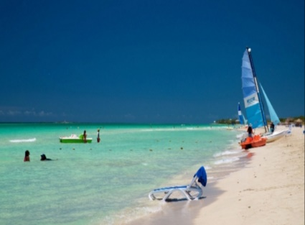
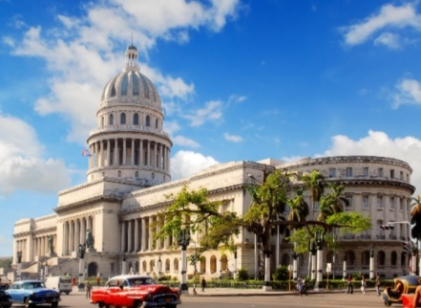
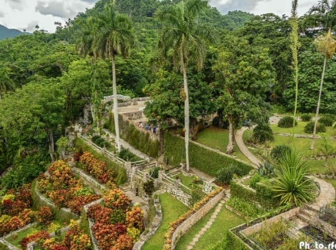

Slide 28
THANK YOU

