Slide 1

University of Artemisa
Social and Humanistic Faculty
Languages Department
TERM PAPER
Author: Juan Manuel Méndez Pérez
Tutor: M Sc: Rosa Lexandra Pérez González

Slide 2
Title: SET OF ACTIVITIES FOR DEVELOPING LISTENING COMPREHENTION SKILLS IN NINTH GRADE STUDENTS AT COMBATE DE SOROA SECONDARY SCHOOL IN CANDELARIA MUNICIPALITY
Título: CONJUNTO DE ACTIVIDADES PARA DESARROLLAR HABILIDADES DE COMPRENSION AUDITIVA EN ESTUDIANTES DE NOVENO GRADO EN LA ESCUELA SECUNDARIA COMBATE DE SOROA DEL MUNICIPIO CANDELARIA

Slide 3
INTRODUCTION

Slide 4
Problematical Situation
Ideal State
Comprehend oral texts about studied contents.
Reproduce pronunciation patterns.
Reproduce oral texts following models.
Interact orally with partners.

Slide 5
Real State
Insufficient comprehension of general and specific information from oral texts.
Difficulties identifying pronunciation elements.
Poor retention and reproduction of the information.
Difficulties when interacting orally with partners.

Slide 6
Contradiction
Ideal State
Real State

Slide 7
Scientific Problem:
How to develop listening comprehension skills of 9th grade students at Combate de Soroa Secondary School from Candelaria municipality?

Slide 8
Object of study:
The teaching-learning process of English in 9th grade.
The development of listening comprehension skills in 9th grade students.
Field of action:

Slide 9
Objective:
To propose a set of activities for developing listening comprehension skills in 9th grade students at Combate de Soroa Secondary School from Candelaria municipality.

Slide 10
Scientific questions:
1.What theoretical methodological references support the development of listening comprehension skills in the teaching learning process of English in 9th grade?
Scientific Task:
1.Determination of the theoretical-methodological references that support the development of listening comprehension skills in the teaching learning process of English in 9th grade.

Slide 11
Theoretical Methods
Analytic-Synthetic.
Inductive-deductive.
Systemic approach.
Historical logical

Slide 12
AUTHORS´CRITERIA
Rosa Antich(1987)
Fan Jagang (1993)
Rodolfo Acosta Padrón (2005)
Sonia Fernández (2014)
Aracelis Góngora (2014)
Rosa Lexandra Pérez (2020)

Slide 13
TEACHING-LEARNING PROCESS
social interactive formative, holistic, integrative process of communication, with strong cognitive and humanistic base. Through it, a group of students enjoy and get responsible of their learning in favorable conditions, solving tasks which meet their needs…
Acosta (2005)

Slide 14
LISTENING COMPREHENSION
Active process that involves receiving auditory stimuli, paying attention to oral language, understanding the meaning of oral symbols to decode the message and responding in oral interaction according to the context.
Fernandez (2014)

Slide 15
SET OF ACTIVITIES
it as a group of intentionally planned connected actions and operations for using and practicing the acquired knowledge to propitiate the development of determined skills.
Pérez (2020)

Slide 16
Scientific questions:
2- What is the current state of the development of listening comprehension skills in 9th grade students at Combate de Soroa Secondary School from Candelaria Municipality?
Scientific tasks:
2-Characterization of the current state of the development of listening comprehension skills in 9th grade students at Combate de Soroa Secondary School from Candelaria municipality.

Slide 17
Population: 9th grade
131 students
Sample
28 students of 9th A (21,4% of the population)
Notes:
17

Slide 18
Empirical methods:
Observation: Instrument: Observation guide.
Survey: Instrument: Questionnaire of survey.
Interview: Instrument: Questionnaire of interview.
Pedagogical test: instrument: English Pedagogical test

Slide 19
Statistical methods:
Descriptive statistics
Percentage analysis

Slide 20
Parameters:
1. Recognition of pronunciation elements
2, Identification of vocabulary items in the oral text.
3. Identification of global information from oral texts
4. Identification of specific information from oral texts.
5. Application of the listened information in oral interaction

Slide 22
Scientific questions:
3. What set of activities to propose for developing listening comprehension skills in 9th grade students at Combate de Soroa Secondary School from Candelaria municipality?
Scientific tasks
3. Proposal of a set of activities for developing listening comprehension skills in 9th grade students at Combate de Soroa Secondary School from Candelaria municipality.

Slide 23
philosophical
psychological
Foundations of the proposal
pedagogical
Didactical
sociological
Notes:
23

Slide 24
Interactive
Reflexive
Characterization of the proposal
Creative
Integrative
Flexible
Notes:
24

Slide 25
Unit 3 the news.
Type of lesson: Application.
Objective: To make use of the communicative function: Talk about the weather based on the comprehension of a videotext.
Content
Lexical: Vocabulary related to weather conditions.
Notes:
25

Slide 26
Grammatical: simple present tense of the verb be.
Functional: Talk about the weather.
Level of assimilation: Production
Method: Conscious practical
Methodological conception: Communicative approach
Form of organization: Individual and pair work
Form of assessment: Oral and written.
Teaching aids: Pictures, video sequence.
Notes:
26

Slide 27
Before listening activities
1. Objective: To predict the content of the video sequence students will listen to
Procedure: The teacher presents some pictures to students and asks questions based on them
Order
These people are doing different activities:
What are they doing?
What seasons of the year are suitable for doing such activities?
What is the weather like in every season?
Notes:
27

Slide 28
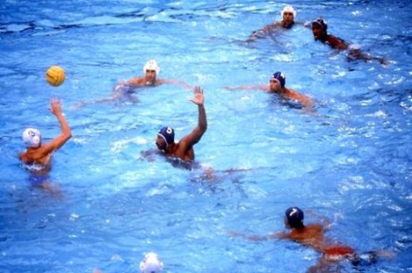
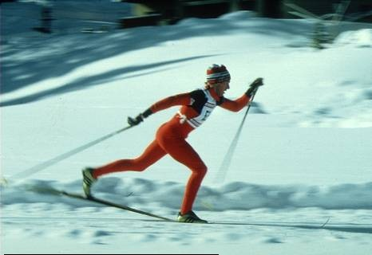

Slide 29
While listening activities
2 Objective: To comprehend general information from the video sequence.
Procedure: Students will be asked to watch and listen to the information in the video and determine what it is about.
Order
Watch the video and tick the right option according to what you listened.
The boy in the video
----Is not interested in the weather conditions.
---- Wants to get wet
---- Is really worried about weather changes
Notes:
29

Slide 30
3. Objective: Determine specific information from a video
Procedure students are asked to complete ideas using the information they listened from the video
Order
Complete the following ideas using information from a video sequence.
The boy puts on his sunglasses, that is because, ------------------
He uses his umbrella because ---------------------------------------
The boy just wears a t-shirt when -----------------------------------
Finally he needs a heavy coat because ----------------------------
Notes:
30

Slide 31
After listening activities
After listening activities
4. Objective: To make use of the communicative function: Talk about the weather by means of a guided dialogue.
Procedure: The teacher will present students a communicative situation and steps for a guided dialogue making use of the studied communicative functions.
Notes:
31

Slide 32
Order
Your classmate Bill wants to go to a baseball game in the afternoon
Help him decide whether going or not according to the weather conditions today, follow the steps in the chart below.
Notes:
32

Slide 33
Bill | you
1Say you have tickets for a baseball game in the afternoon and ask what the weather is like | 1Answer his question and recommend him to go or not according to the weather
2Thank your friend for his advice | 2Answer and close the talk with a good-bye phrase

Slide 34
CONCLUSIONS

Slide 35
Recommendation

Slide 36
Thank you

