Slide 1

University of Artemisa
Social and Humanistic Faculty
Languages Department
TERM PAPER
Author: Zoila Dayana Fernández León
Tutor: Msc. Patricia Fundora Ramírez

Slide 2
Title: SET OF ACTIVITIES FOR INCREASING WRITING SKILLS THROUGH ENGLISH LESSONS IN 7TH GRADE AT RIGOBERTO CORCHO SECONDARY SCHOOL IN ARTEMISA MUNICIPALITY.
Título: CONJUNTO DE ACTIVIDADES PARA INCREMENTAR LAS HABILIDADES DE ESCRITURA A TRAVES DE LAS CLASES DE INGLES EN 7mo GRADO EN LA ESCUELA SECUNDARIA RIGOBERTO CORCHO EN EL MUNICIPIO DE ARTEMISA.

Slide 3
Problematical Situation
Ideal State
● To write simple narrations.
● To write simple descriptions.
● To write simple texts to narrate daily activities.

Slide 4
Real State
● Students have difficulties with activities for increasing writing skills.
● Students do not organize the ideas.
● Students have difficulties with the spelling, syntax, and punctuation.

Slide 5
Contradiction
Ideal State
Real State

Slide 6
Scientific Problem:
How to increase the writing skills through English lessons in 7th grade at Rigoberto Corcho secondary school in Artemisa municipality?

Slide 7
Object of study:
The teaching-learning process of the English subject in 7th grade.
The increasment of writing skills through English lessons in 7th grade at Rigoberto Corcho secondary school in Artemisa municipality.
Field of action:

Slide 8
Objective:
To propose a set of activities for increasing writing skills through English lessons in 7th grade at Rigoberto Corcho secondary school in Artemisa municipality.

Slide 9
Scientific questions:
1-What are the theoretical and methodological references in the teaching –learning process of writing skills through English lessons in 7th grade?
Scientific tasks:
1-Determination of the theoretical-methodological references in the teaching-learning process of English subject related to writing skills through English lessons in 7th grade.

Slide 10
Theoretical Methods
● Analytic-Synthetic.
● Inductive-deductive.

Slide 11
Scientific questions:
2-What is the initial state concerning to writing skills through English lessons in 7th grade?
Scientific tasks:
2-Characterization of the initial state concerning to the increasment of writing skills lessons in 7th grade?

Slide 12
Population: 7th grade
65 students
Sample
24 students

Slide 13
Empirical methods:
● Survey to students: Instrument: Guide of survey.
● Interview to teachers: Instrument: Guide of interview.
● Pedagogical test: Instrument: English Pedagogical test.
● Observation Guide: Instrument: Guide of observation

Slide 14
Parameters:
●Order of ideas using different texts.
●The correct use of syntax through different texts.
●The correct use of spelling and punctuation using different texts.

Slide 15
Results of the Initial State

Slide 16
Scientific questions:
3-What set of activities can be elaborated to increase writing skills through English lessons in 7th grade at Rigoberto Corcho secondary school in Artemisa municipality?
Scientific tasks:
3-Elaboration of a set of activities for increasing writing skills through English lessons in 7th grade at Rigoberto Corcho secondary school in Artemisa municipality.

Slide 17
Activity #
Grade:7th grade
Unit 2: What is your town like?
Type of activity: Application
Objective: To describe a town in a paragraph form using different adjectives and pictures with correct syntax, spelling, and punctuation.
Content: Adjectives, Simple Present Tense
Method: Conscious Practical
Teaching aids: Pictures
Level of assimilation: Production
Form of activity organization: Individual work
Form of assessment: written and oral

Slide 18
Procedure:
The teacher asks to the students:
Do you remember the adjectives you can use to describe a place?
Can you mention some of them?
What is the opposite of them?
The teacher writes them on the board with its opposites respectively.
clean dirty modern ancient
beautiful ugly quiet noisy
large small wonderful terrible
Then , the teacher shows pictures of the town of Artemisa and the students are going to describe them using the adjectives of the board, in a simple paragraph.
The students are going to read the paragraph in front of the class aloud.

Slide 19
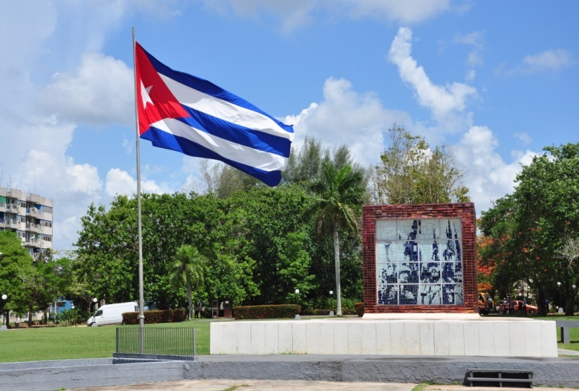
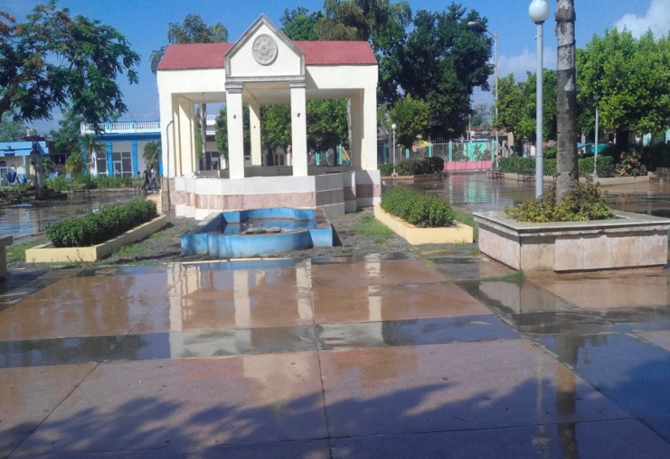
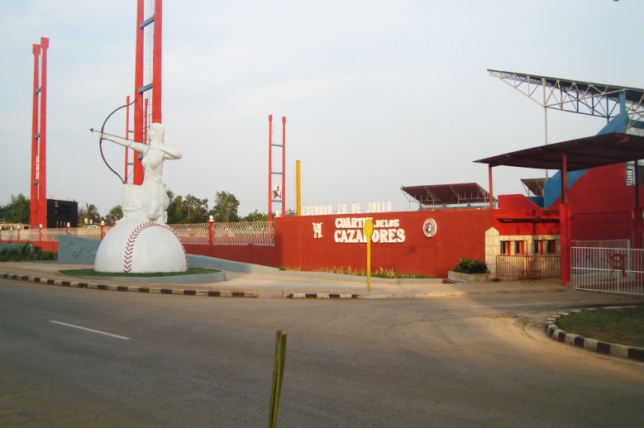
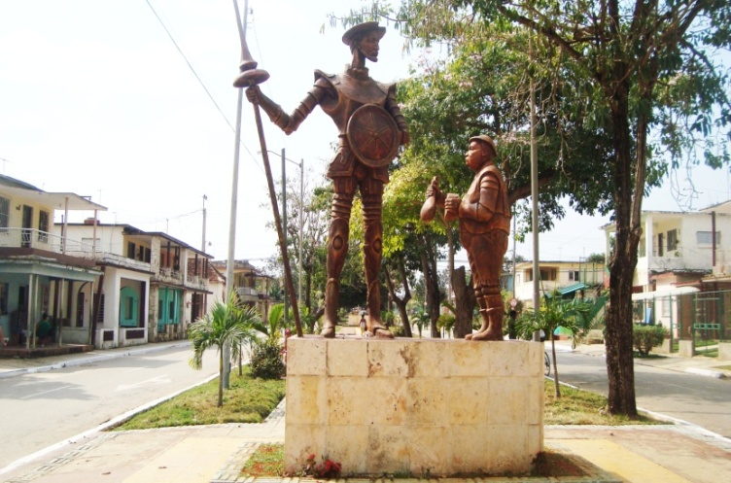
Activity:
Look at the pictures. Describe the town that appears in them using the adjectives, in a simple paragraph in Simple Present Tense.
a) Read the paragraph in front of the class aloud.

Slide 20
Practical Contribution
The set of activities takes into account the objectives and contents related to the English subject.

Slide 21
Conclusions

