Slide 1
ARTEMISA UNIVERSITY
SCHOOL OF SOCIAL SCIENCES
AND HUMANITIES
TERM PAPER
Author: Odaisy de la Caridad Cabrera Pontones
Tutor:Msc Rosa Lexandra Perez Gonzales
Artemisa 2019-2020

Slide 2
TITLE: SET OF ACTIVITIES FOR DEVELOPING
ORAL INTERACTION IN RELATION
TO TOURISM IN SECONDARY SCHOOL
TÍTULO: CONJUNTO DE ACTIVIDADES PARA
EL DESARROLLO DE LA INTERACCIÓN
ORAL EN RELACIÓN CON EL TURISMO
EN LA SECUNDARIA BÁSICA

Slide 3
Problematical Situation
Ideal State
According to the 9th grade syllabus students
should be able to:
Hold a spontaneous, short conversation about personal
experience and future plans.
Prepare and present oral reports about previously studied
themes
Show comprehension of single oral texts
Interact with partners orally with acceptable linguistic accuracy.
Use communicative strategies to begin, continue and end a conversation.
Describe basically places specifically in unit 2 Travel time

Slide 4
Real State
Students show limitations such as:
Lack of vocabulary items to establish a conversation.
Poor grammar structures especially verbal tenses.
Difficulties in pronouncing English sounds.
Problems in elaborating oral texts.
Insecurity when interacting orally with partners.
Troubles to continue and end a conversation when they cannot remember a determined word or phrase.
Insufficient knowledge about tourist places in the locality and their main traits

Slide 5
Contradiction
Ideal State
Real State

Slide 6
Scientific Problem
How to improve oral interaction in relation to tourism in 9th grade students at Combate de Río Hondo secondary school from San Cristobal municipality?

Slide 7
Object if study
The teaching learning process of English in 9th grade.
Field of action
The improvement of oral interaction in relation to tourism in the locality through English lessons in 9th grade students

Slide 8
Objective
To propose a set of activities for improving oral interaction in relation to tourism in the locality through English lessons in 9th grade students at Combate de Río Hondo secondary school from San Cristobal municipality.

Slide 9
Scientific question:
1-What are the theoretical-methodological references related to the improvement of oral interaction in relation to tourism through English lessons in 9th grade?
Scientific task:
1-Determination of the theoretical-methodological references related to the improvement of oral interaction in relation to tourism through English lessons in 9th grade.

Slide 10
Theoretical Methods
-Historical logical
-Analysis synthesis
-Induction deduction

Slide 11
Autor’s Criteria
Camacho, (2018)
Richards (1997)
Hunziker. K (1990)
Amable Faedo Borges (1989)
Bertolino: A (1988)
Finocchiaro (1983)

Slide 12
“…speaking is divided into two branches spoken production and spoken interaction”. In reference to this the same source recognizes that “production in the form of storytelling can be considered as a further development in orally and eventually literacy while interaction comprises understanding oral information and producing the oral message in correspondence”. So, it “involves two or more parties co-constructing discourse …it is considered to be the origin of language, with interpersonal, collaborative and transactional functions”.
Common European Framework of Reference for Languages: Learning, Teaching, and Assessment
Companion Volume with New Descriptors publishing@coe.int).
© Council of Europe, February 2018
Teaching learning process

Slide 13
“…interaction comprises understanding oral information and producing the oral message in correspondence. So, it “involves two or more parties co-constructing discourse …it is considered to be the origin of language, with interpersonal, collaborative and transactional functions”
Common European Framework of Reference for Languages (CEFR) (2018)
Oral interaction

Slide 14
”… tourist activity that tourist and tourist agents carry out with respect for receptive places from the environmental, cultural, social and economic point of view, at the same time the receptive community accepts and respects, and the public authorities protect and foster”
United Nation World Tourism Organization (UNWTO) (2009)
Definition of tourism

Slide 15
-A set is a collection considered as a unit, a collection of things considered together and usually having something in common (Encarta 2009).
-Activity is a type of task that involves more than one action by the student or students to develop it (Valdés 2005).
-A set of activities may be defined as a group of actions related and articulated one and other guided to reach certain objectives (Perez 2012)
Set of activity

Slide 16
Scientific question:
2- What is the current state of oral interaction in relation to tourism in the locality through English lessons in 9th grade students at Combate de Rio Hondo secondary school in San Cristobal municipality?
Scientific task:
2-Characterization of the current state of oral interaction in relation to tourism in the locality through English lessons in 9th grade students at Combate de Rio Hondo secondary school in San Cristobal municipality.

Slide 17
Population: 9th grade
158 Students
Sample
(intentional)
30 Students
18%

Slide 18
Empirical Methods
-Observation:Instrument: Observation guide
-Survey: Instrument: Questionnaire of survey to teachers to students
-Pedagogical Test: Instrument: English pedagogical test

Slide 19
Parameters
1- Recognition of words and phrases associated with tourism
2- Correct pronunciation of words
3- Use of words and phrases in the appropriate grammatical form.
4- Use of words and phrases on the appropriate situation and level of formality.

Slide 20
Characterization of the current state

Slide 21
Scientific question:
3-What characteristics should have a set of activities for improving oral interaction in relation to tourism in the locality for 9th grade student at Combate de Rio Hondo secondary school in San Cristobal municipality?
Scientific task:
3-Proposal of a set of activities for improving oral interaction in relation to tourism in the locality through English lessons in 9th grade students at Combate de Rio Hondo secondary school in San Cristobal municipality.

Slide 22
Pedagogical
Philosophy Psychology
Didactical Sociological
Proposal Fundation

Slide 23
- The main objective of the proposal is to improve oral interaction in 9th grade students.
–The set of activities will be inserted in Unit 2 Travel Time, it is compound of 5 activities.
-They are designed to be used in the presentation, practice and application lessons.
-They comprise different levels of assimilation such as: recognition, reproduction and production.
-They were elaborated in accordance to students’ age, needs, interests, traits, close development zone and potential development
-According to the grade syllabus the subject comprise 120 hours distributed in 10 units. Each unit will comprise 12 hours and every unit will dedicate approximately 1 hour to the exercise designed for each one
Characterization of the proposal

Slide 24
Unit | Object | Content | Level of assimilation | Number of activity
2 | To make a conversation about different kinds of food using the typical Cuban dishes in simple present tense. | Type of food (rice, fried chicken, shrimps) | Production | 2
2 | To explain the different tourist modalities which are applied in Soroa | Vocabulary related to tourism modalities applied in Soroa to the guest. | Production | 1
2 | To create a dialogue talking to account characteristics of places in the locality it poising it main facilities of the places. | Different places in Soroa ( Orquidário, El salto, El mirador de Soroa) | Production | 3
2 | Talking to account the main characteristic present and oral report about a remarkable tourist place in your locality. | Places (orquideareo, Soroa´s hotel, el salto de soroa) | Reproduction | 4
2 | To infer the names given to determined elements using contextual explanation. | Questions: (where is located the botanic garden Orquideario de Soroa?; What is its temperature? ; Found in the text four nouns, and two adjectives) | Reproduction | 5

Slide 25
Characterization of the activities
Creative: The students have to use their imagination to participate actively and creatively.
Reflexive: The activities demand student’s concentration and activate their thinking capacity.
Interactive: The students should interact among them and with the teacher to solve the activities.
Flexible: The activities are designed to be according to students needs and interest.

Slide 26
Activity 2:
Type of activity: Production
Objective: To make a conversation about different kinds of food using the typical Cuban dishes in simple present tense.
Content: Type of food (rise, fried chicken, shrimps)
Form of organization: Work in pair
Level of assimilation: Production
Methodological conception: Communicative approach
Method: Conscious practical
Teaching aids: Pictures the board
Communicative functions: talks about type of foods
Procedure: Students will be asked to identify different foods and specially a Cuban one afterwards, should develop several question and expose in the class, and they are going to create a dialogue and present it in pairs.

Slide 27
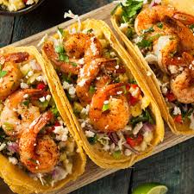
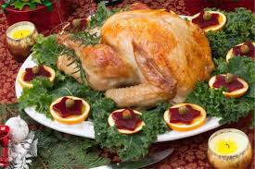
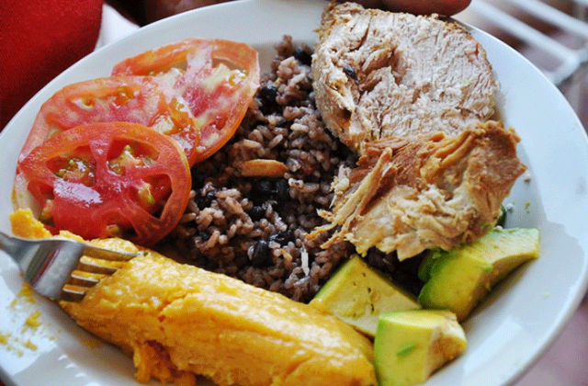
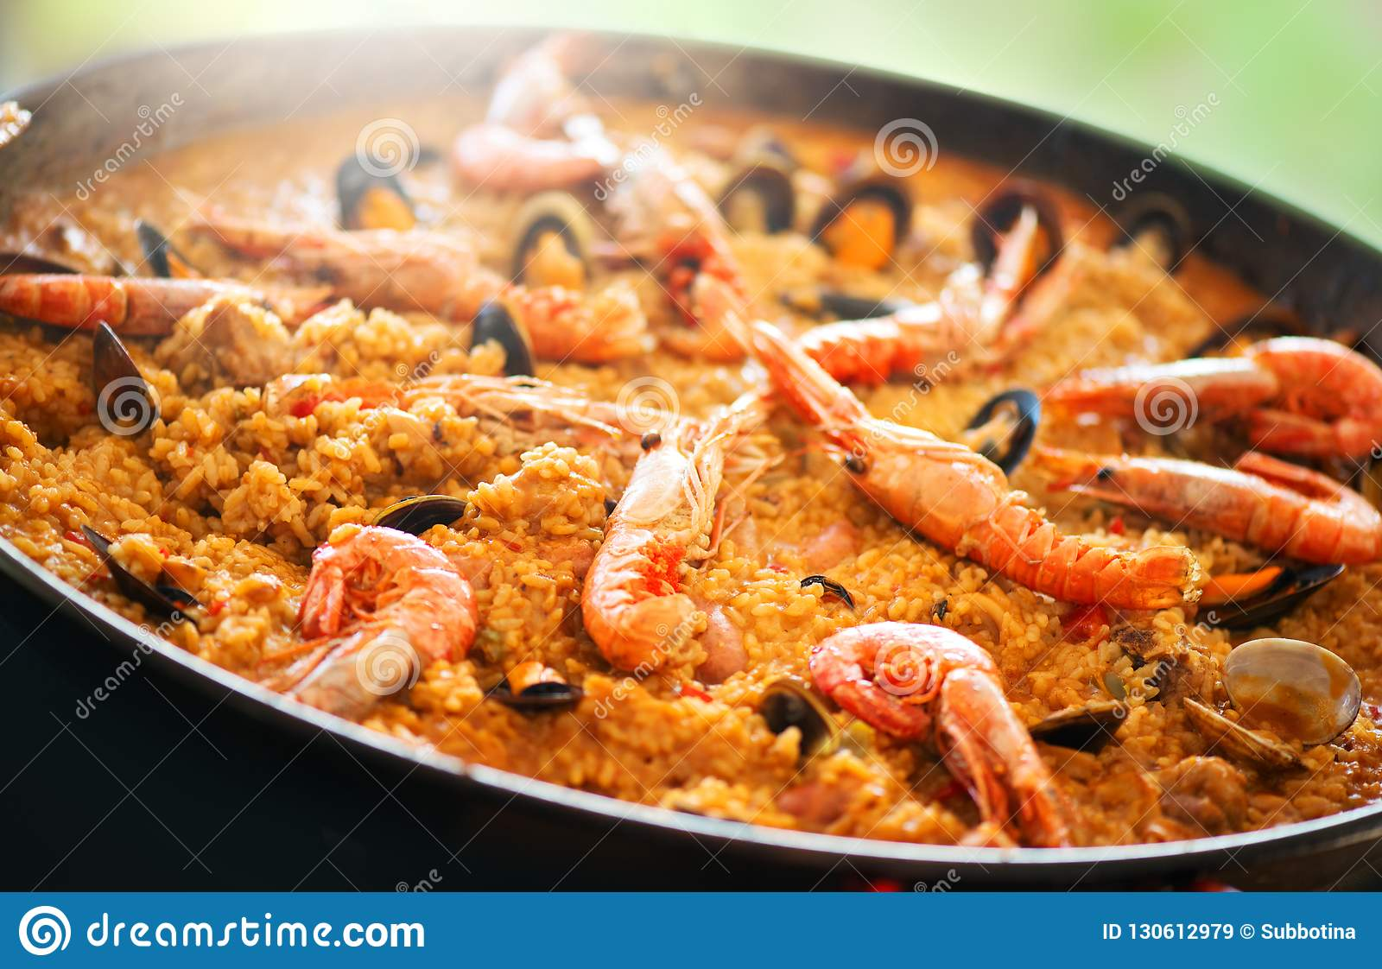
Observe the following illustrations and name the meals that are represented
a-) Which of them represents a typical Cuban dish? Tell you to your partner.
a
b
c
d

Slide 28
2.1-Respond the following questions in class:
What is your favorite food?
What do you prefer eating in the morning as a breakfast?
Do you like the spaghetti? Why?
2.2- Imagine that you go to the caffeteria and your partner is a waiter/waitress and you elabore a dialogue introducing this words:
.Fried Chicken
.Rice
.Juice
.Coffe

Slide 29
Scientific question 4:
4-What results will be obtained with the application of a set of activities for improving oral interaction contributing to the development of tourism in the locality through English lessons in 9th grade students at Combate de Rio Hondo Secondary School in San Cristóbal municipality?
Scientific task 4:
4-Assessment of the results obtained with the application of a set of activities for improving oral interaction contributing to the development of tourism in the locality through English lessons in 9th grade students at Combate de Rio Hondo Secondary School in San Cristóbal municipality.

Slide 30
Conclusion

Slide 31
THANK YOU

